Slide 1
Website
Auditing

Slide 2
Overview
Outandaboutcommunicaion
I
Worthpointe
Coastal Payroll

Slide 3
Website Design/User Experience
Professional website design
Relevant headlines and page copy
Mobile friendly
Professional digital branding
User friendly navigation
Relevant use of images and video

Slide 4
Understanding the problems
01
Email Privacy: hello@outandaboutcomm.com
02
Problems: Click on the email address will direct us to a blank page;
Plain text email address can be susceptible to email spammers.
03
Suggestions: Remove plain text email address and replace it with image or contact form; Make sure the users will not be directed to blank page by clicking on the email.

Slide 5
Understanding the Problems
Usability: Every web page on our company’s website has the issue of shaking.
Amount of Content: Our web page has a low volume of text content which search engines can interpret as “thin content”

Slide 6
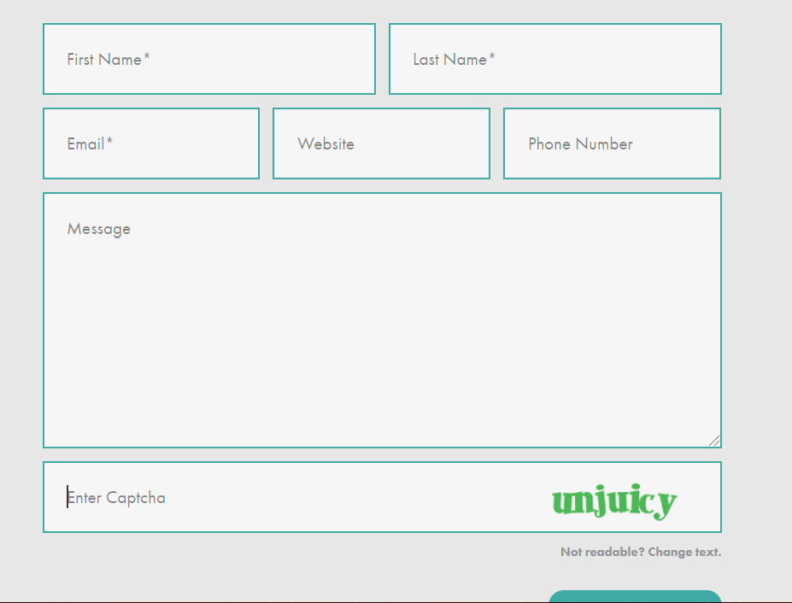
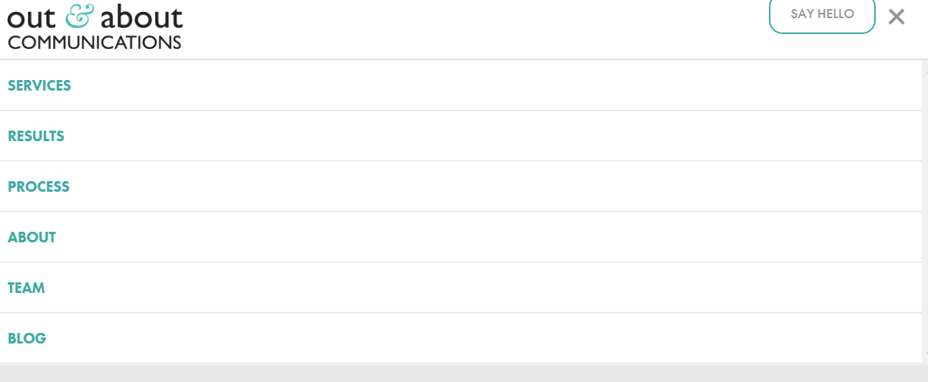
Contact Us Page
1 .It's better to remove the captcha test.
2 .Redirect to a thank you page after the customers submitted a message that explains when and how we'll be responding and links to other useful content.
3. Add an option that can direct our customers to the contact us page.

Slide 7
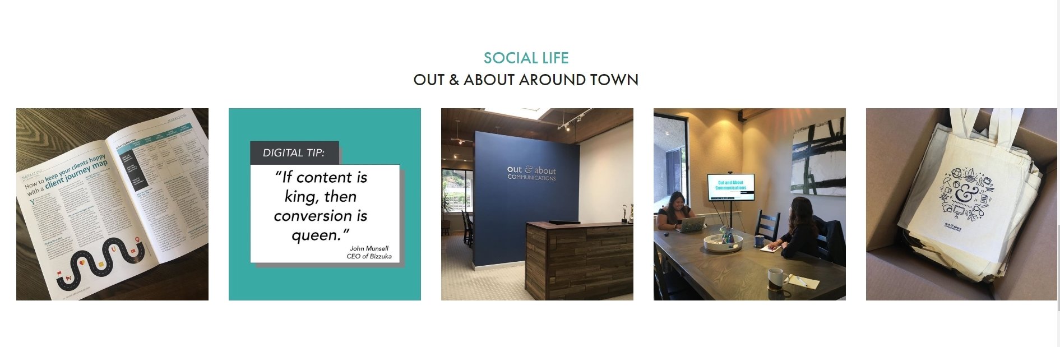
Service Page
1. This page doesn’t have any link that can direct us to the projects we’ve done for our customers.
2. Change the way we display the photos of our working environment

Slide 8
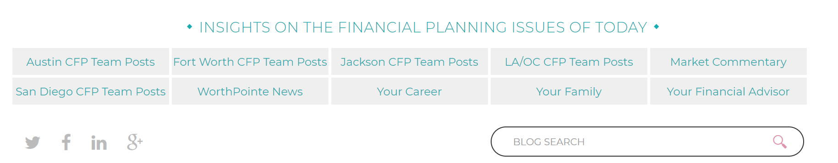
Worthpointe
Need sufficient color contrast between the texts and the white background behind it.

Slide 9

Worthpointe
2. Decrease the amount of white space.

Slide 10
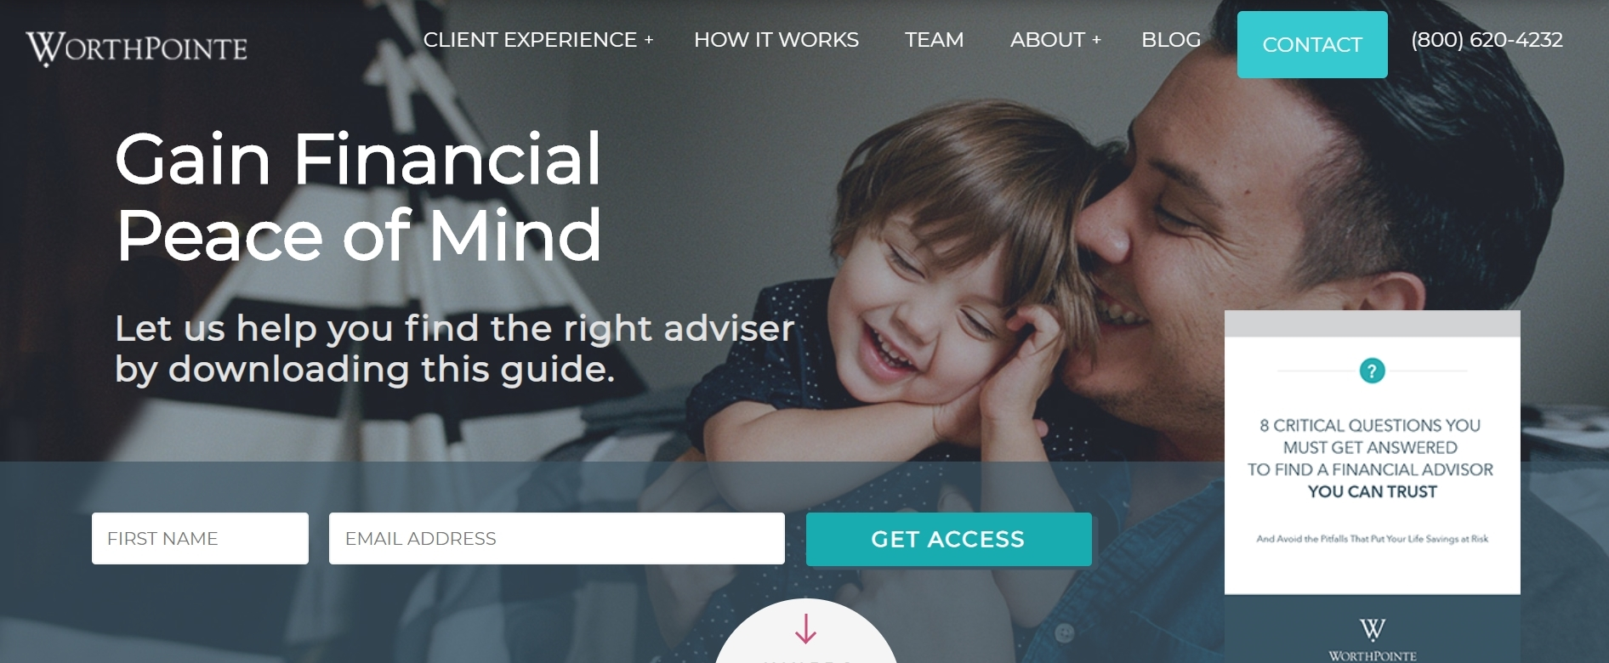
Worthpointe-Homepage
1. Change the background image
2. Remove the small window on the right side.

Slide 11
Coastal Payroll
Website Color Schemes
04
Company Culture
Fun and professional
Combines warm accent color with clean white background to make for a crisp and welcoming palette.
01
03
Features
Design
Contains a special web page that introduces the team members.
Attractive and unique. It can engage the first-users on the highest level.
02
Problem: It doesn’t provide company’s email address on the contact page.

